Slide 1

Day-1
HTML and Web Pages
Explained By:
Yashitha N,
Trainee Engineer,
Flipkart Internet Pvt. Ltd

Slide 2
HTML?
HTML is not a programming language
A type of SGML (standard generalized markup language)
HTML uses paired tags to markup different elements of a page
We will discuss XHTML later.
Language that drives web pages in WWW
It is where we will start the semester

Slide 3
Editing Your HTML File
Try not to use Notepad use EditPlus instead
WYSIWYG editor, like FrontPage
PHP Designer or HTMLGateFree
Familiarize with the mechanics
Without using WISIWYG like Frontpage
Understand the coding behind web pages
Provides you the knowledge to make changes

Slide 4
Words to remember
Tag
  Used to specify special regions to the web browser. Tags look like this: <tag>
Element
  A complete tag, having an opening <tag> and a closing <tag>.
Attribute
  Used to modify the value of the HTML element. Elements will often have multiple attributes.

Slide 5
Element?
An element consists of three basic parts: an opening tag, the element's content, and finally, a closing tag.
<p> - opening paragraph tag
Element Content - paragraph content
</p> - closing tag
Every webpage contains four basic elements. The html, head, title, and body elements.

Slide 6
More elements
<html> begins and ends each and every web page.
The <head> element comes next.
  Tags placed within the head element are not directly displayed by browsers.
Place the <title> tag within the <head> element to title your page. The title will be displayed at the top of a viewer's browser.
The <body> element is where all content is placed. Paragraphs, pictures, tables, etc.

Slide 7
A Simple HTML File – ex1.html
      <html>
      <head>
      <title>A Simple HTML Example</title>
      </head>
      <body>
      HTML is Easy To Learn</H1>
      Welcome to the world of HTML.
      </body>
      </html>

Slide 8
Exercise – ex1.html
Using Filezilla – open marqone.busadm.mu.edu
Enter user name and password
mkdir – “exercise”
Go into the exercise directory
create ex1.html with HTMLGateFree
Test it before you download to the “server”
Download and test https://marqone.busadm.mu.edu/~user/exercise/ex1.html

Slide 9
Tags
Tags are embedded commands within a document that communicate to the browser.
<opening tag> Content </closing tag>
Any number of white-spaces are compressed into a single one
Examples of Tags
  <p>Paragraph Tag</p>
  <h2>Heading Tag</h2>
  <b>Bold Tag</b> or <strong> Bold Tag </strong>
  <i>Italic Tag</i> or <em> Italic Tag </i>

Slide 10
More HTML tags
Tags Without Closing Tags
They still have the 3 basic parts (opening/closing and content).
do not require a formal </closingtag>
Examples:
  <img src="mypic.jpg" /> -- Image Tag
  <br /> -- Line Break Tag
  <input type="text" size="12" /> -- Input Field

Slide 11
Lists – un-numbered
Unnumbered Lists:
  <UL>
    <LI> apples </LI>
    <LI> bananas </LI>
    <LI> grapefruit </LI>
  </UL>
Unnumbered Lists with different pointer types:
  <UL type="square">
    <LI> oranges </LI>
    <LI> peaches </LI>
    <LI> grapes </LI>
  </UL>
  type="square"
  type="disc"
  type="circle"

Slide 12
Lists - numbered
Unnumbered Lists:
  <UL>
    <LI> apples </LI>
    <LI> bananas </LI>
    <LI> grapefruit </LI>
  </UL>
Numbered Lists:
  <OL>
    <LI> oranges </LI>
    <LI> peaches </LI>
    <LI> grapes </LI>
  </OL>

Slide 13
Lists - numbered
Numbered Lists that starts with 4:
  <OL start="4">
    <LI> oranges </LI>
    <LI> peaches </LI>
    <LI> grapes </LI>
  </OL>
Numbered Lists with different ordering:
  <OL type="a">
    <LI> oranges </LI>
    <LI> peaches </LI>
    <LI> grapes </LI>
  </OL>
  type="a": a, b, c
  type="A": A, B, C
  type="i": i, ii, iii
  type="I": I, II, III

Slide 14
Lists
TIPS
Use the start and type attributes to customize your lists. It is possible to make lists of lists, which is helpful for creating some items, such as outlines.

Slide 15
Put it all together so far
<HTML>
<HEAD>
<TITLE>The document title</TITLE>
</HEAD>
<BODY>
<H1>Main heading</H1>
<P>A paragraph.</P>
<P>Another paragraph.</P>
<UL> Things that I like </UL>
<LI>A list item.</LI>
<LI>Another list item.</LI>
</UL>
</BODY>
</HTML>

Slide 16
Block vs. Inline Elements
<h2><em>This header will be bold and italicized</em></h2>
OR
<em><h2>This header will be bold and italicized</h2></em>
<em> and <h2> are different kinds of tags.
<h2>: header elements are BLOCK-LEVEL elements.
<em>: is an INLINE-LEVEL element.

Slide 17
Formatting
<p>An example of <b>Bold Text</b> </p>
<p>An example of <em>Emphasized Text</em> </p>
<p>An example of <strong>Strong Text</strong> </p>
<p>An example of <i>Italic Text</i> </p>
<p>An example of <sup>superscripted Text</sup> </p>
<p>An example of <sub>subscripted Text</sub> </p>
<p>An example of <del>struckthrough Text</del> </p>
<p>An example of <code>Computer Code Text</code> </p>
<center>Centering of text in page</center>

Slide 18
Hyperlinks
The most important capability of HTML
Both text and image can serve as anchors for the link
  <a HREF=http://www.mu.edu>Marquette University</a>
  <a HREF=http://www.mu.edu> <IMG SRC="mu.gif"></a>

Slide 19
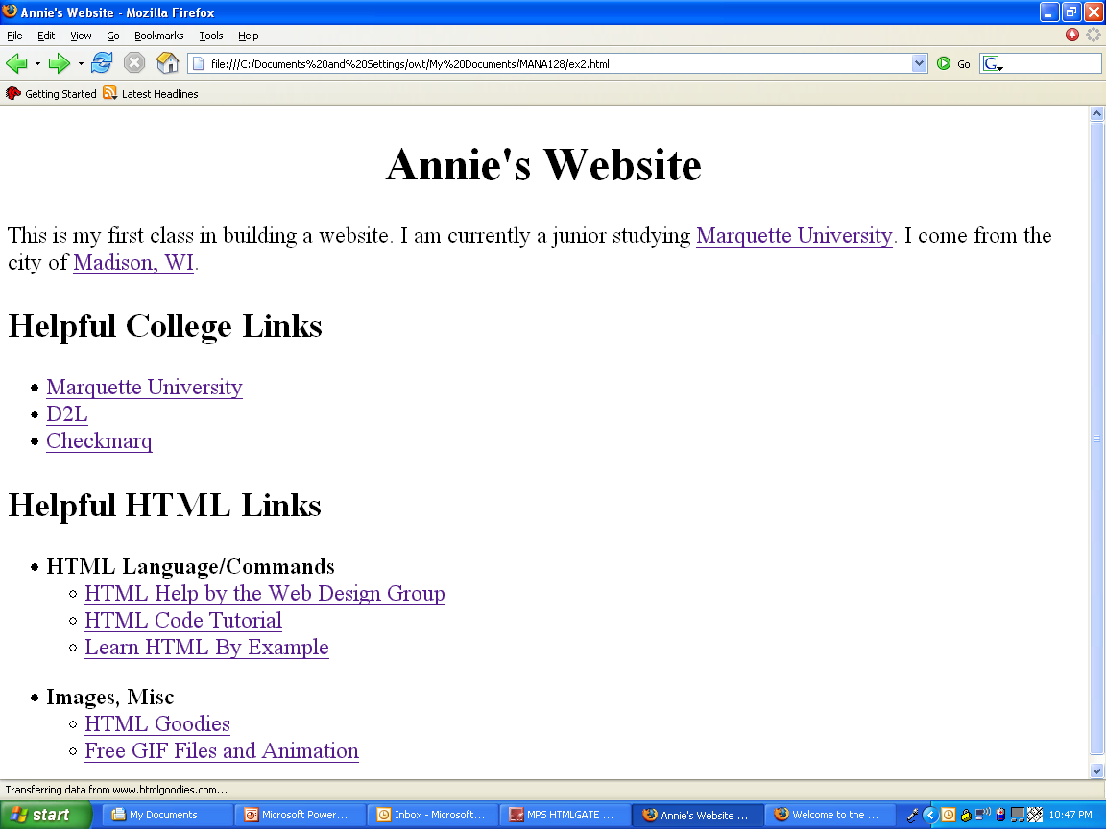
Exercise: ex2.html

